Slide 1
Object and Arrays

Slide 2
Object
In JavaScript, an object is an unordered collection of key-value pairs. Each key-value pair is called a property.
The key of a property can be a string. And the value of a property can be any value, e.g., a string ,number, array or a function.

Slide 3
Accessing Properties
The Dot notation
Bracket notation

Slide 4
Modifying the value of the Property
To change the value of a Property use the assignment operator(=)

Slide 5
Adding a new Property
You can also add a new property after creation unlike other languages like Java.

Slide 6
Deleting a Property
To delete a property use the delete operator.

Slide 7
Checking if a Property exist
To check if a property exist use the in operator which will return true or false .

Slide 8
The This Keyword
The this keyword refers to an object that is executing the current piece of code. It references the object that is executing the current function.

Slide 9
Arrays
In JavaScript, an array is an ordered list of values. Each value is called an element specified by an index.
An JavaScript array has the following characteristics:
First, an array can hold values of mixed types. For example, you can have an array that stores elements with the types number, string, and boolean.
Second, the size of an array is dynamic and auto-growing. In other words, you don’t need to specify the array size upfront.

Slide 10
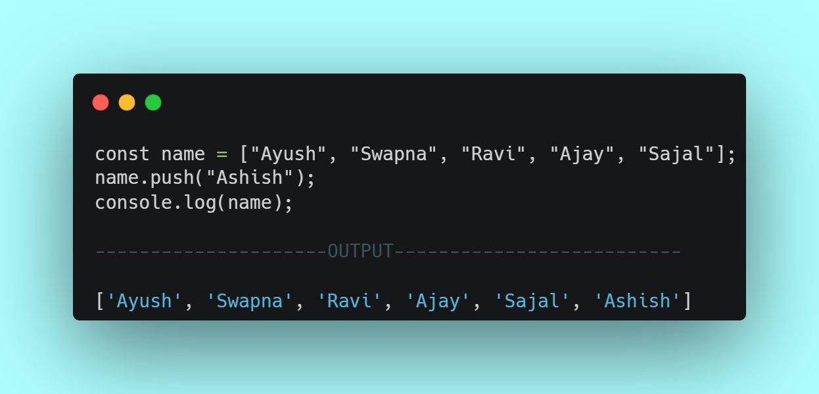
Push - Add a new item at the end of an array.

Slide 11
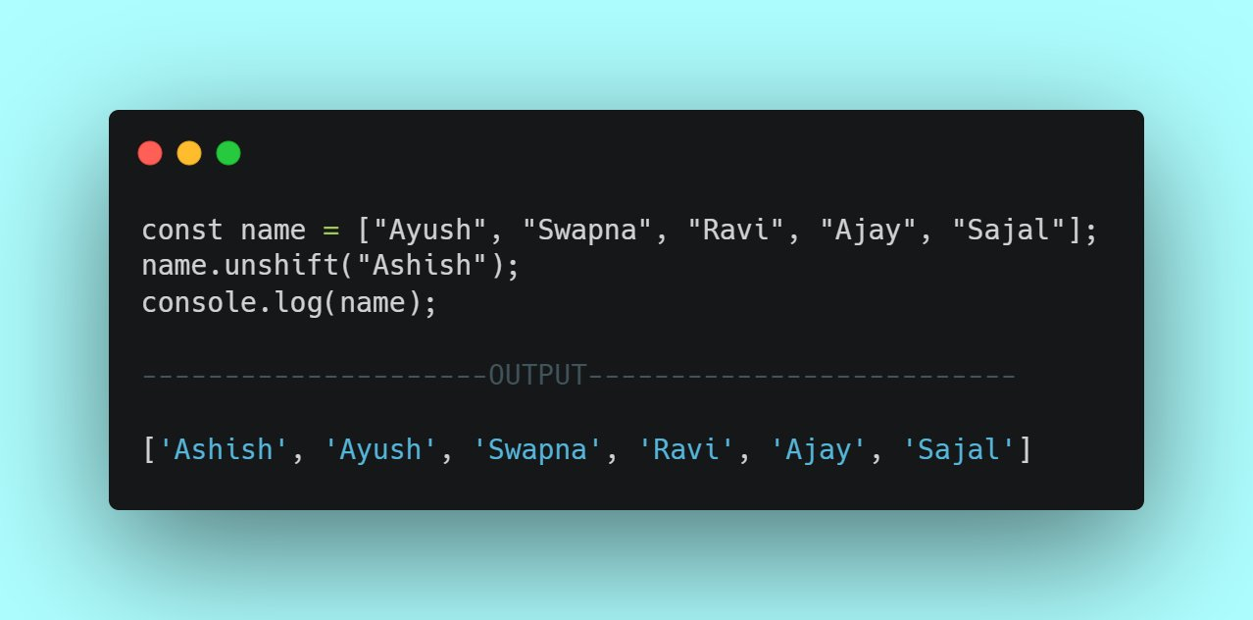
Unshift – Adds a new item at the start of the array.

Slide 12
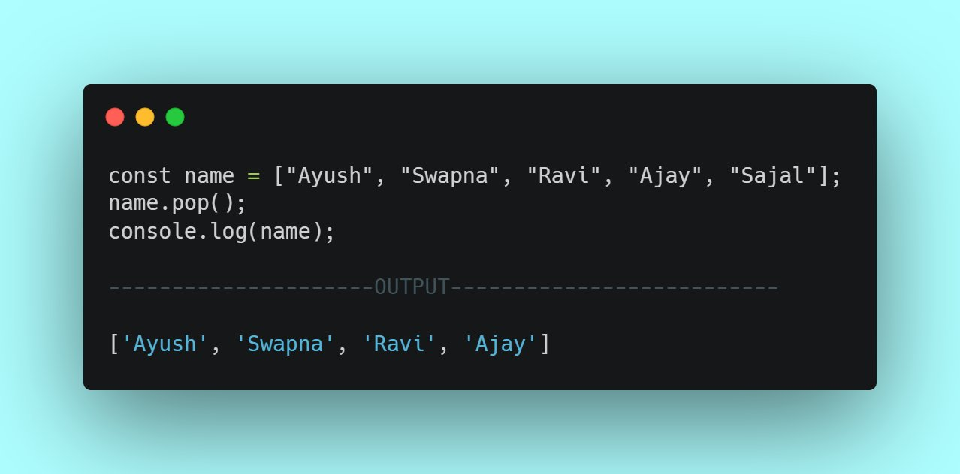
Pop- Removes an item from thr end of the array

Slide 13
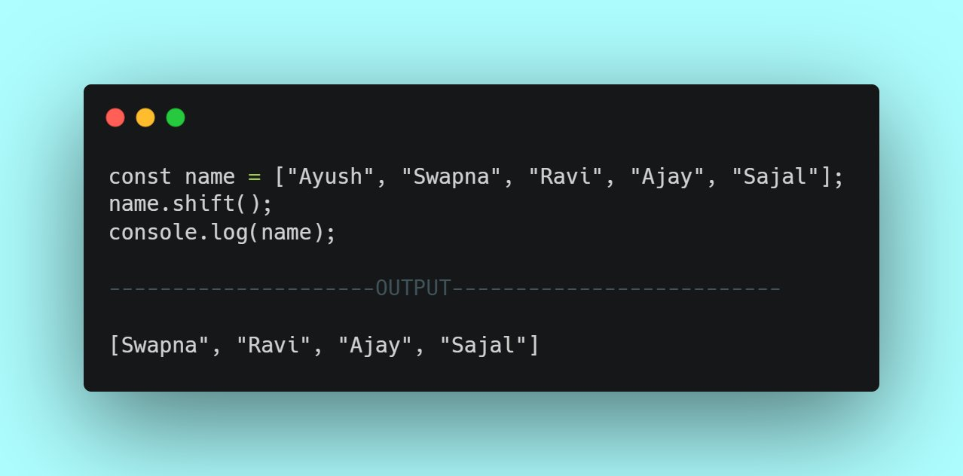
Shift method- Removes an item from the start of the array

Slide 14
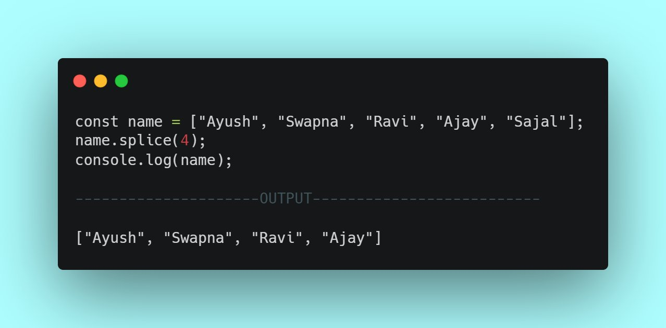
Splice – keeps the defined number of element

Slide 15
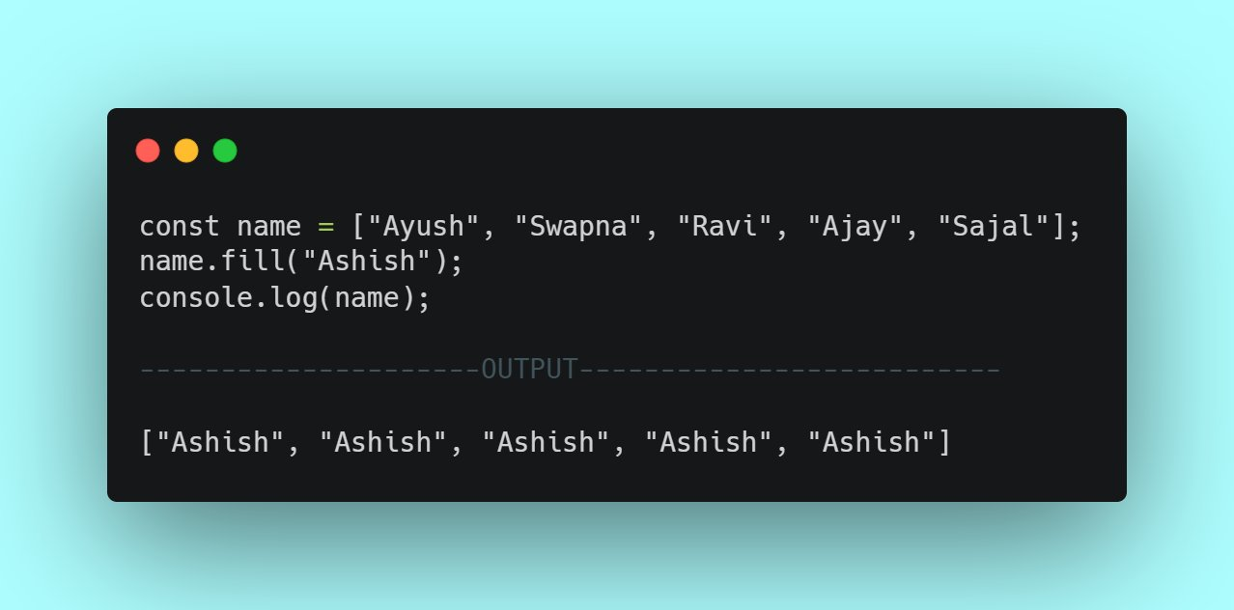
Fill- Fills the whole array with defined items.

Slide 16
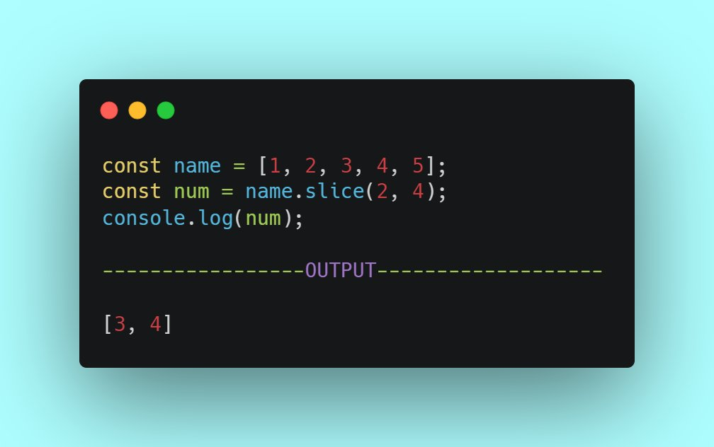
Slice – selects a specific portion of the array

Slide 17
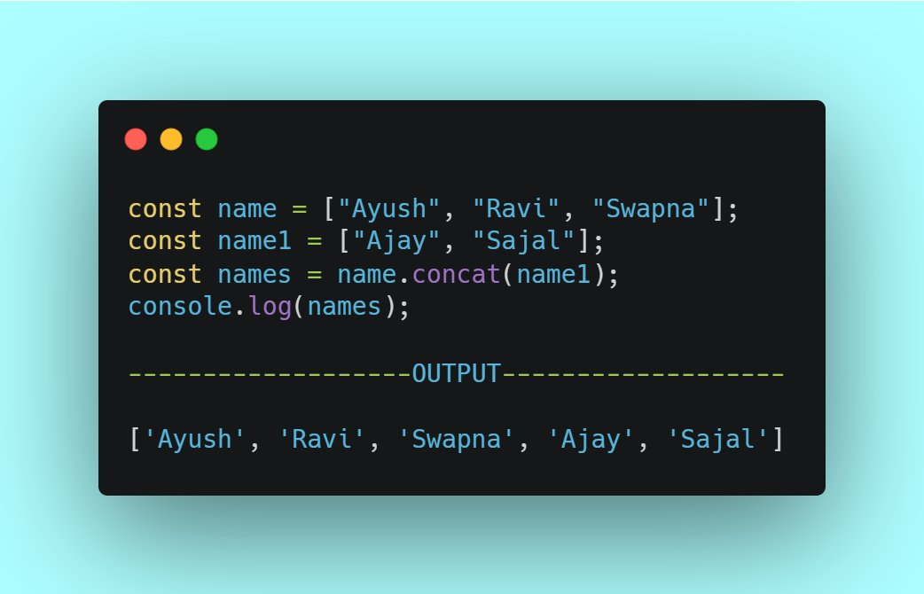
Concat – joins two array

Slide 18
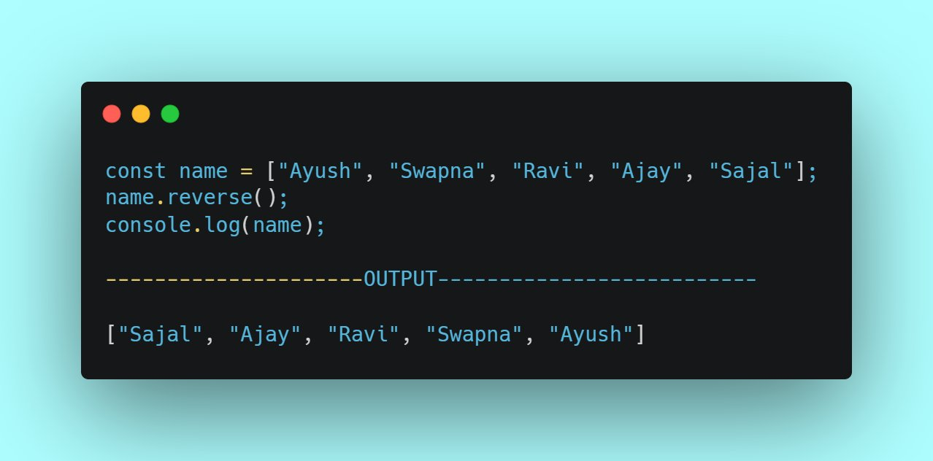
Reverse – Reverses the whole array

Slide 19
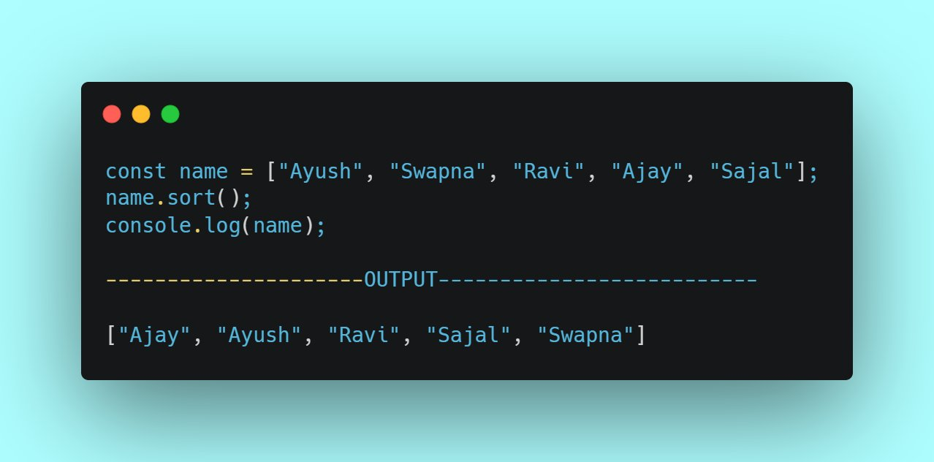
Sort – Sort the whole array alphabetically

Slide 20
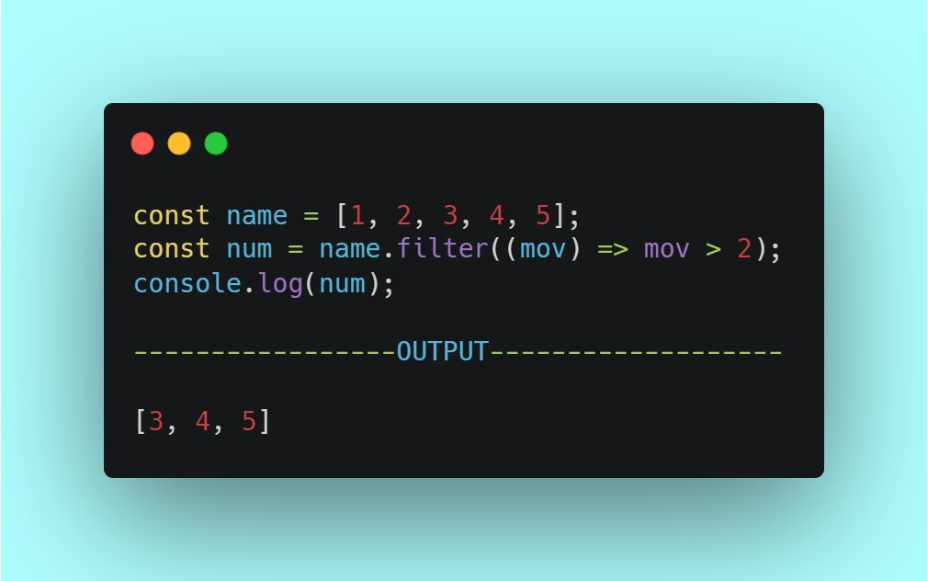
Filter –Returns the items which meet a condition

Slide 21
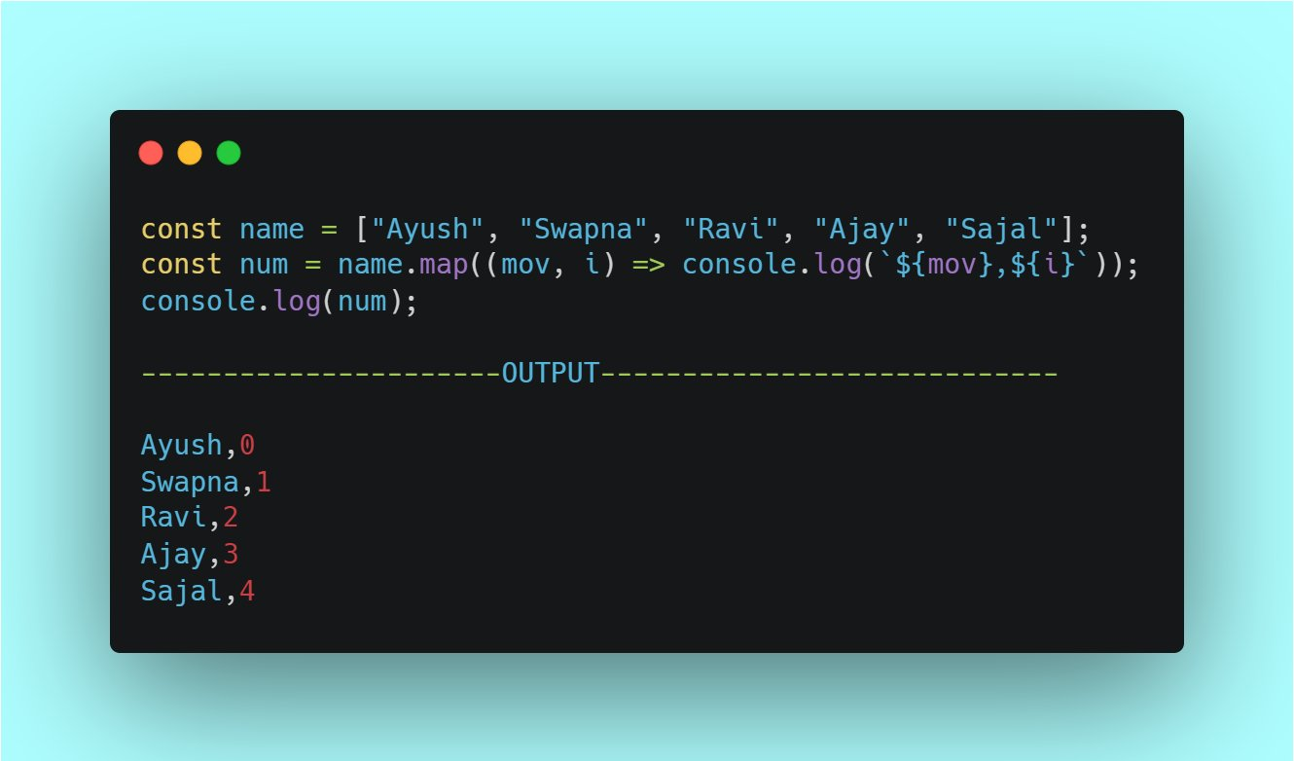
Map- Loops the whole array and return the item and index

Slide 22

Flat – Returns a new Array with all sub-array elements concantenated into it

Slide 23
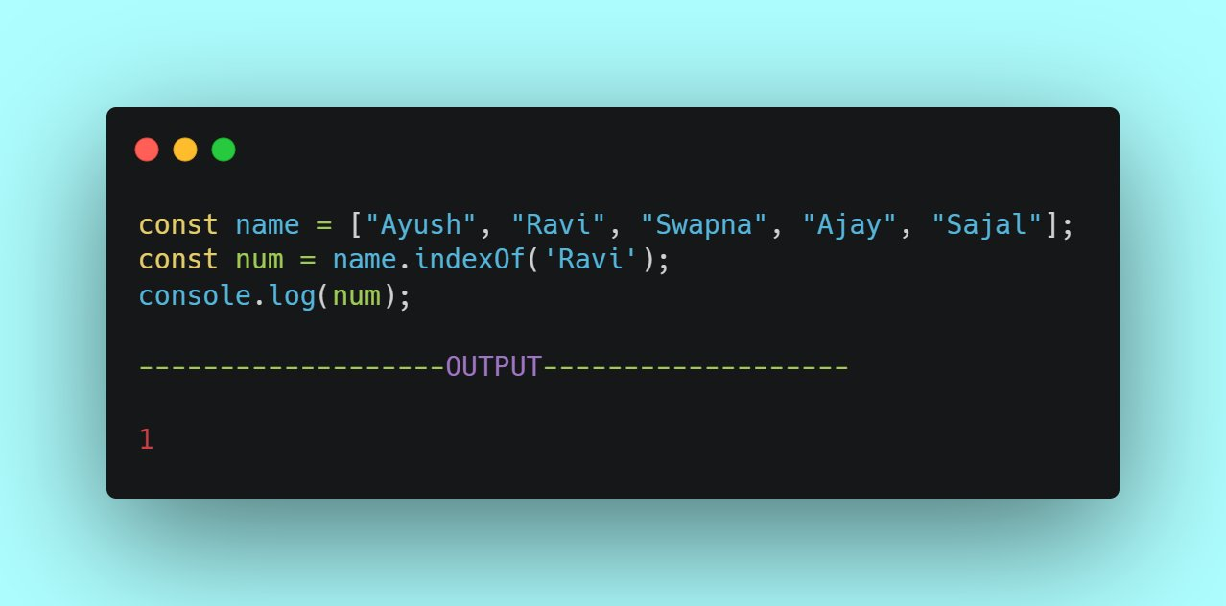
indexOf- Returns the index of the item

Slide 24
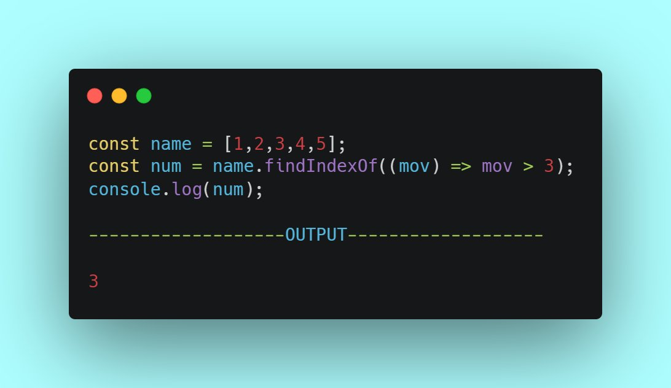
findIndex- Returns the index of the first item that passes the condition

Slide 25
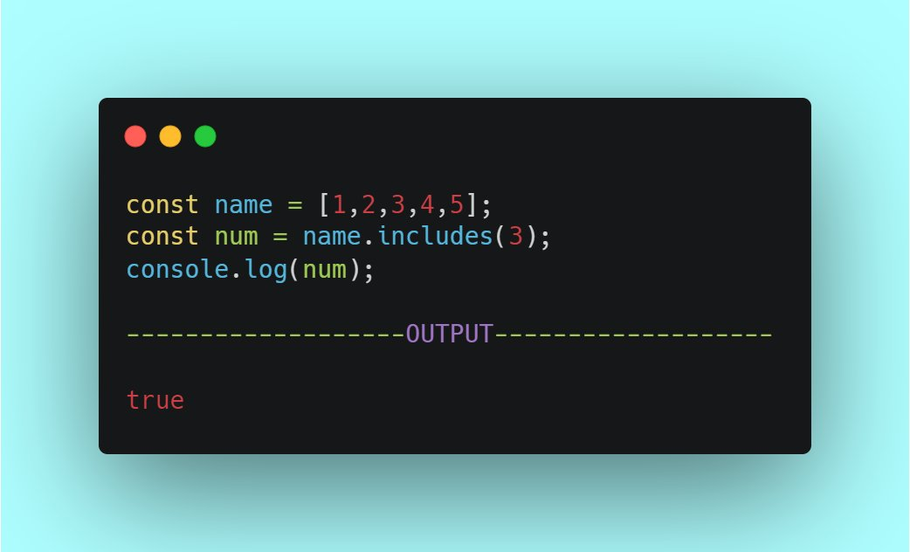
Includes – Checks if a specific item is in the array or not

Slide 26
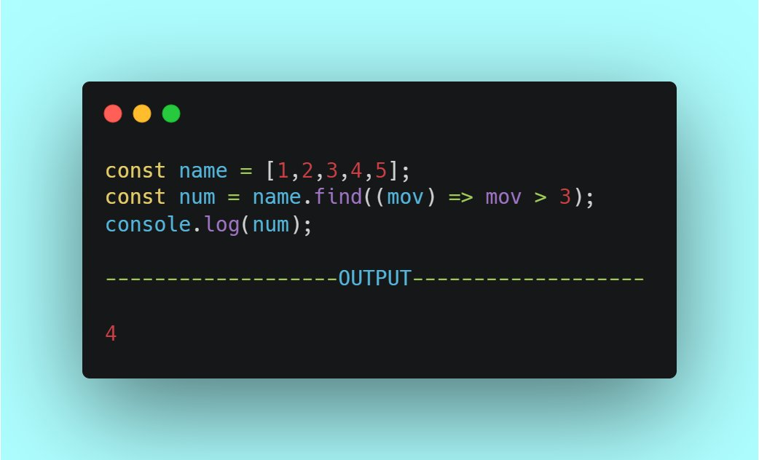
Find – Returns the first item that passes the condition

Slide 27
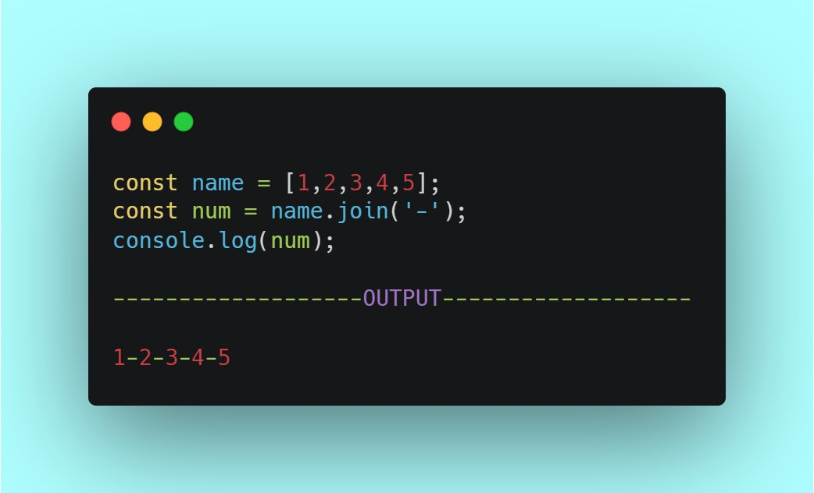
Join – joins all the items with a specific item between them

